Slide 1
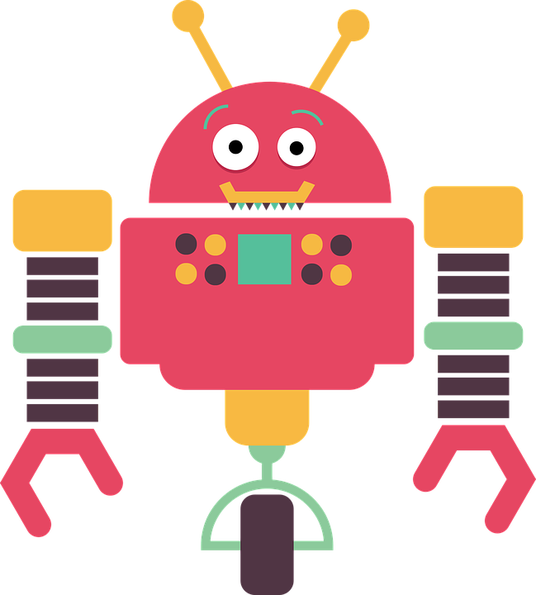
The Chatbots are Coming!
1

Slide 2
Background

Slide 3
Aidan Morgan
PROFESSIONAL EXPERIENCE
Software Engineer
Thales Australia – Software Systems Architect
Satalyst – Chief Technology Officer
Stuck – Chief Troublemaking Officer
Boundlss – Head of Engineering
PhD Candidate - UWA
System Architect – WAMbot (DARPA Challenge)
ACADEMIC EXPERIENCE

Slide 4
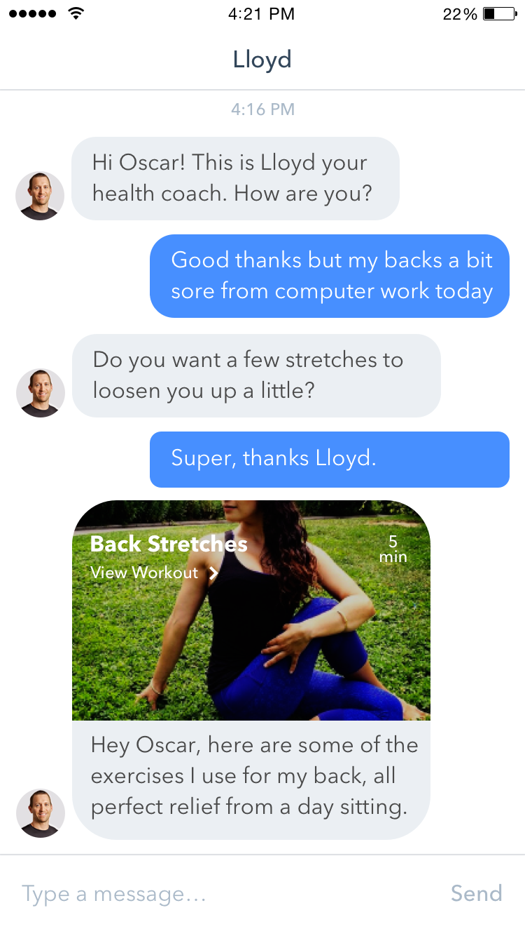
Boundlss
AIM
Our aim is to substantially improves the health & wellbeing of millions of people.

Slide 5


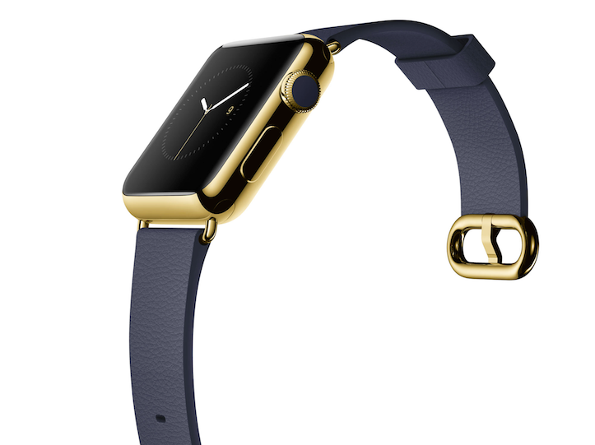
Boundlss
HUMAN-AI HEALTH BOT
Blended human-AI health & wellness assistant.
+
REAL TIME HEALTH & ACTIVITY DATA
250+ wearables, biosensors & health apps.

Slide 6
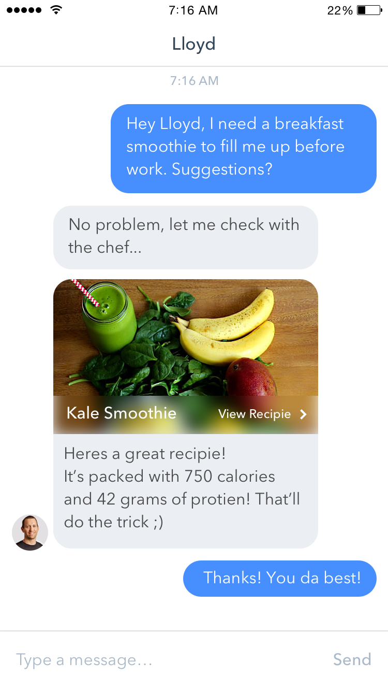
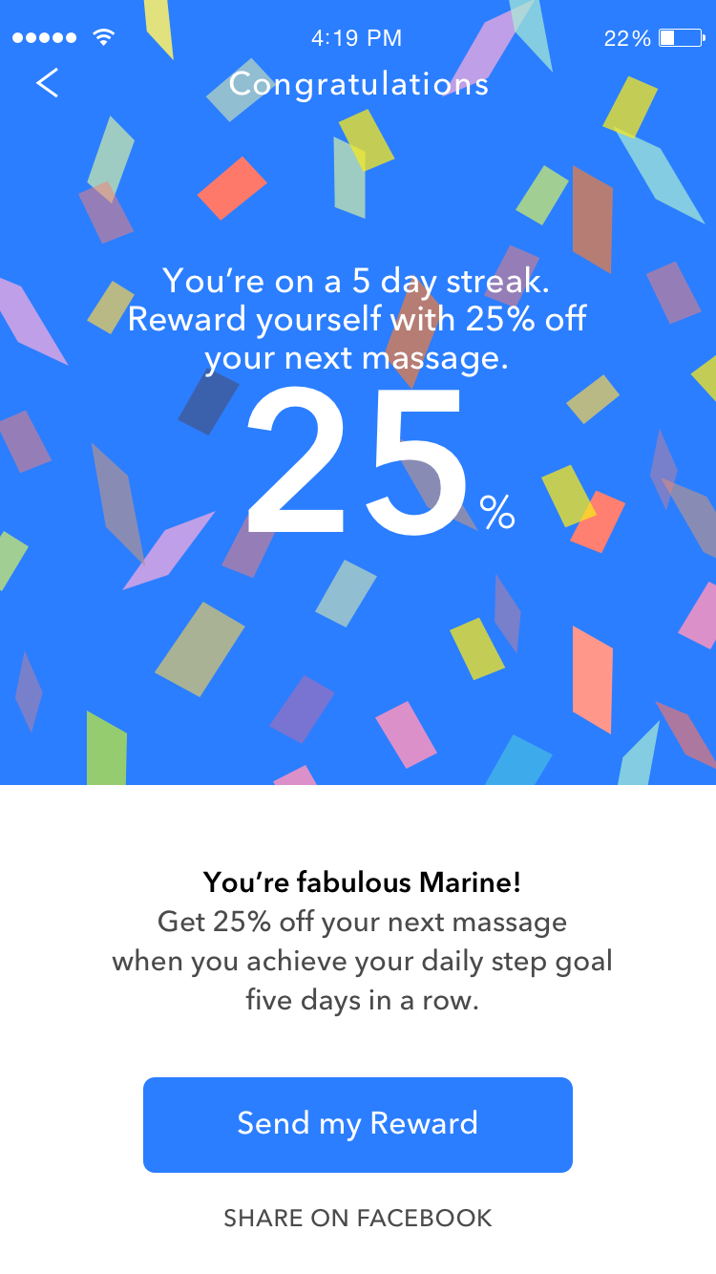
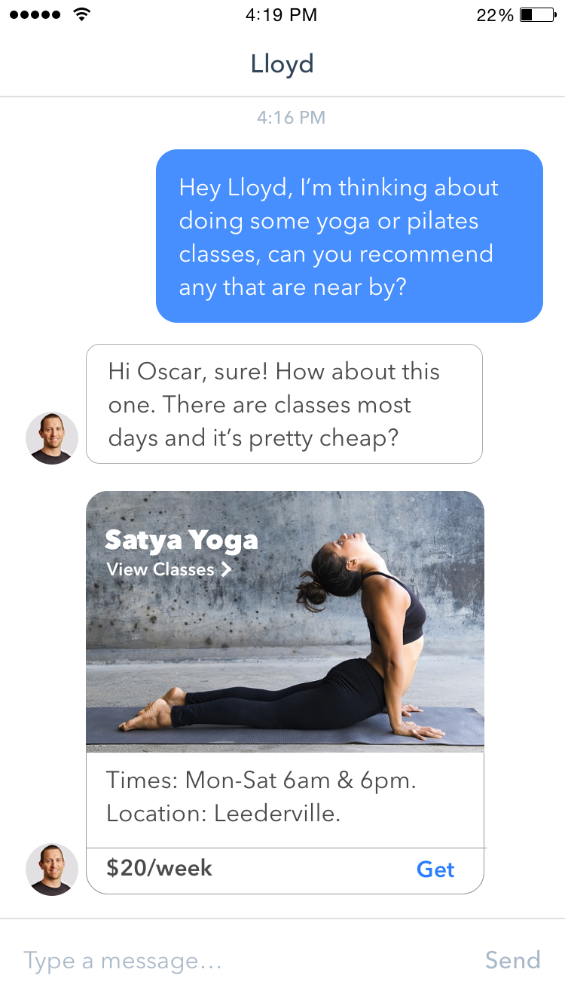
Boundlss
HUMAN-AI HEALTH BOT
Encourage and reward healthy lifestyles: discounts on premiums & health services.
Recipes
Rewards
Classes

Slide 7
Background
OVERVIEW
What are chatbots?
Why now?
Opportunities
Build a Chatbot
Tips for building your own Chatbot

Slide 8
WHAT ARE CHATBOTS
What are we even talking about?

Slide 9
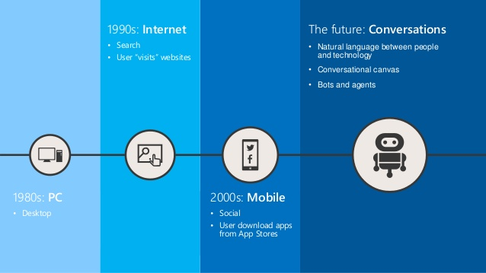
Notes:
Search – long lists of blue links
Whats after conversations? Agents in Personal Assitants. Chatbots are a “stepping stone”.

Slide 10
What are Chatbots?
USER INTERFACE THAT MIMICS TALKING TO A HUMAN
Interact in human terms
Function on top of messaging platforms
10￼

Slide 11
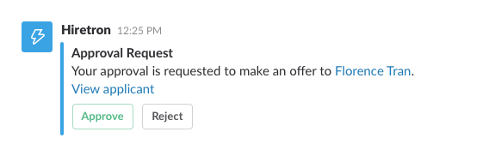
What are Chatbots?
COMMAND BOTS
Command Line over Chat
Structured syntax
No Intelligence

Slide 12
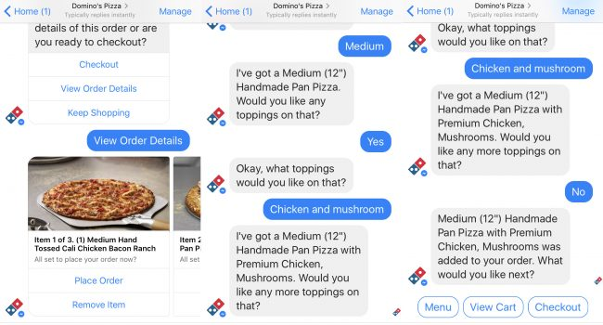
What are Chatbots?
TASK-BASED
Multi-step “form filling”
Scripted Conversations

Slide 13
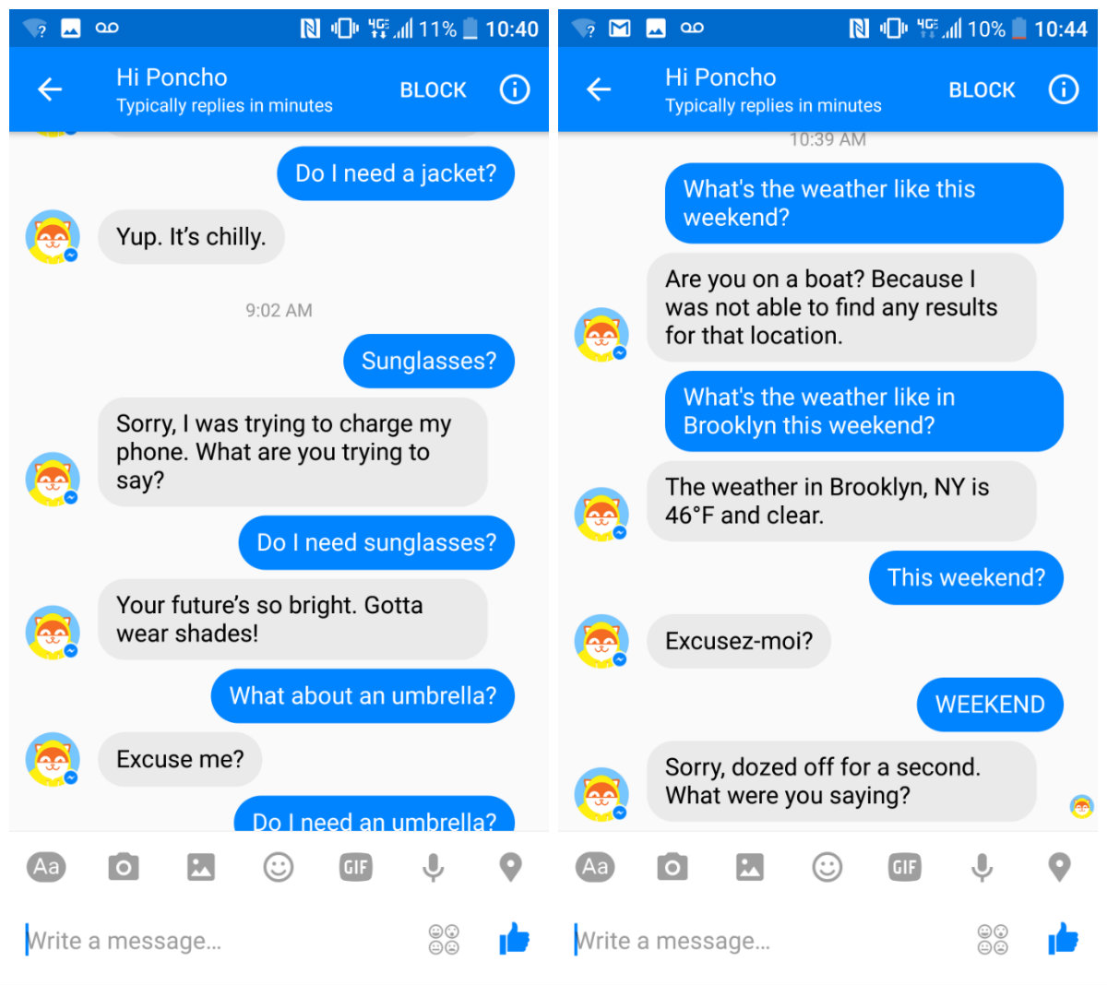
What are Chatbots?
CONVERSATIONAL
Intelligent
Free-form interaction
Knowledge of customer/previous interactions
Notes:
Have some memory of previous conversation
Can understand user’s intent

Slide 14
WHY NOW?
Everyone is suddenly talking about chatbots…

Slide 15
Why Now?
SATYA NADELLA, MICROSOFT CEO
“Chatbots will fundamentally revolutionize how computing is experienced by everybody.”
15￼

Slide 16
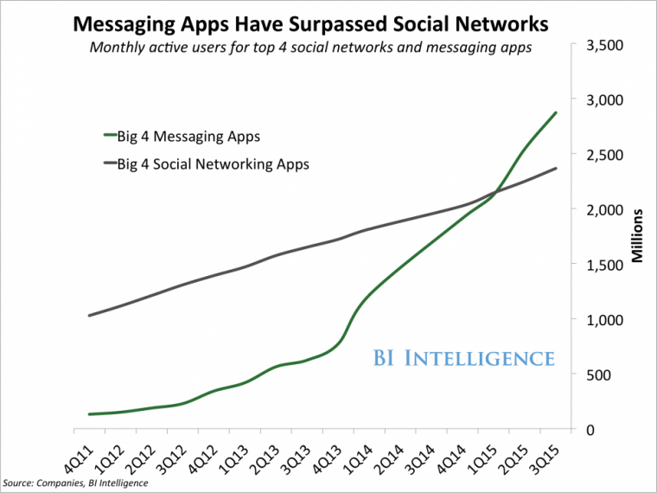
Why Now?
GROWTH OF MESSAGING
Messaging has surpassed social media
Notes:
Facebook Messenger alone has already 1.2 billion monthly active users, and Facebook is reaching almost 2 billion people

Slide 17
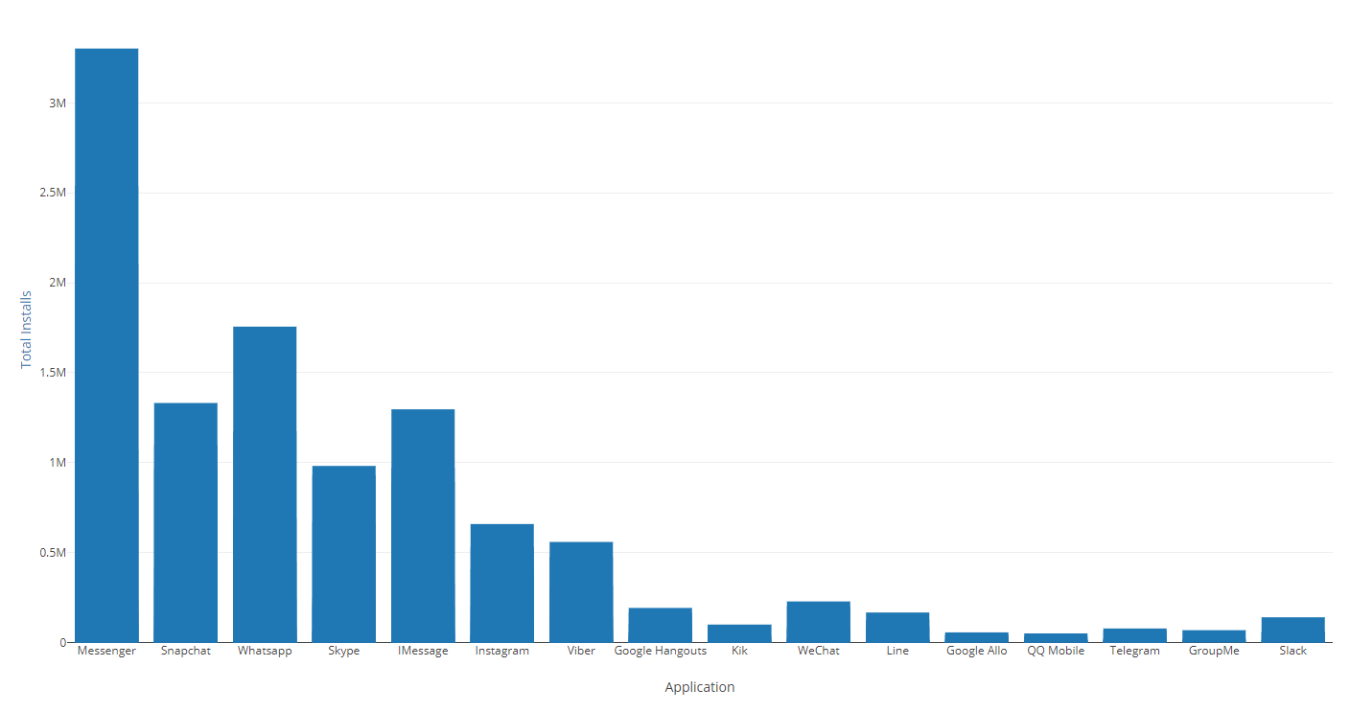
Why Now?
GROWTH OF MESSAGING
Messaging has surpassed social media

Slide 18
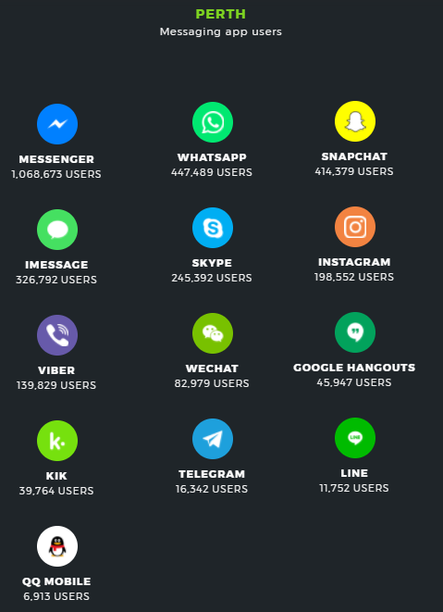

Slide 19
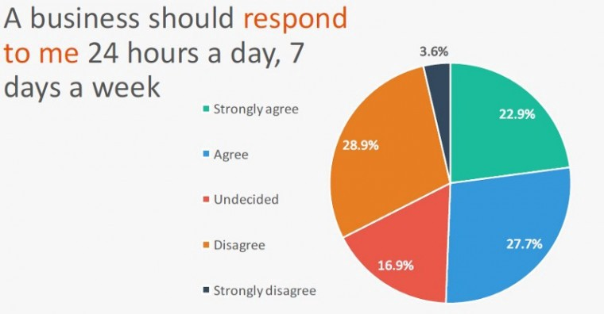
Why Now?
INCREASED USER EXPECTATIONS
Primary form of communication for 65% of Millennials, Gen X-ers and Boomers

Slide 20
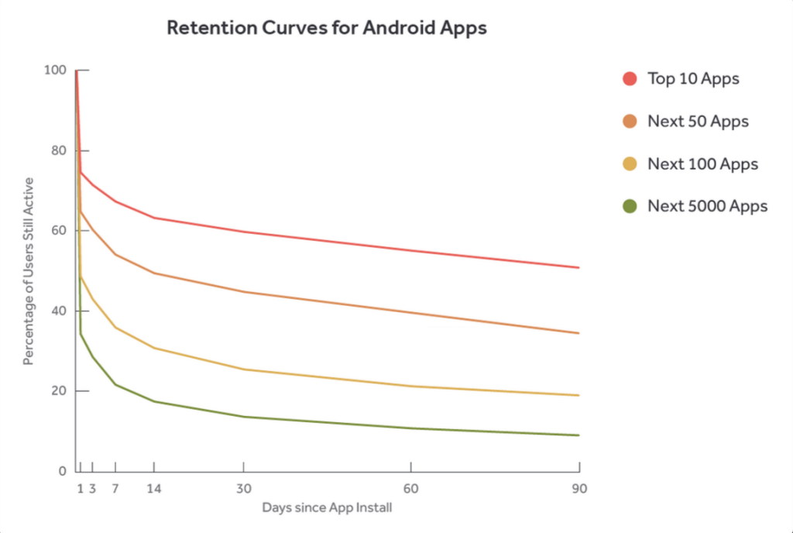
Why Now?
APPS SUCK
23% of users abandon apps after just 1 use
Bots are cheaper, easier and faster to develop and experiment with

Slide 21




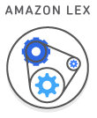


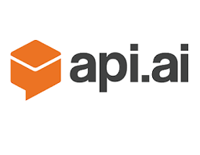




Why Now?
AI & CONVERSATIONAL INTERFACES
AI and conversational interfaces maturing.

Slide 22
Why Now?
GENERALIST AI Your mum.
ARTIFICIAL INTELLIGENCE
Moving from simple tasks to a ‘generalist’ AI.
SPECIALIST Drive an Uber.
TASK Book an Uber.
22￼
22

Slide 23
OPPORTUNITIES
So what does this mean for
my customers/my team/me?

Slide 24
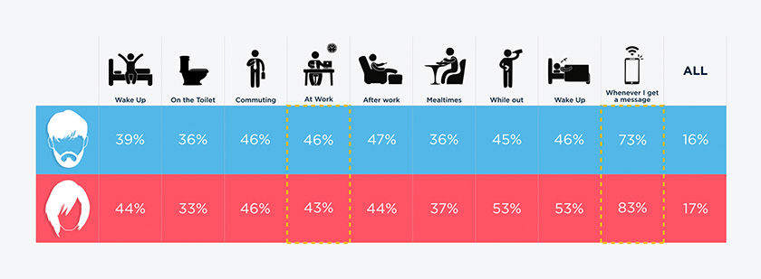
Opportunities
CAPTIVE AUDIENCE
Notes:
Notifications are key. Challenge is getting users to keep app installed – then keeping notifications enabled.

Slide 25
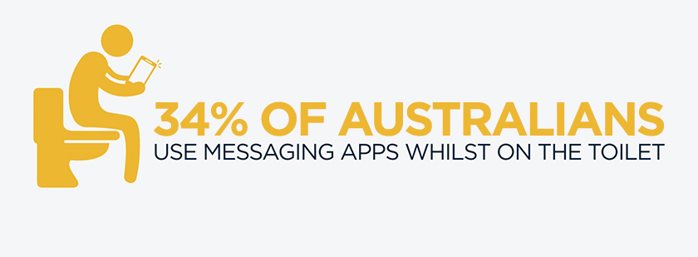
Opportunities
THE REAL CAPTIVE AUDIENCE?

Slide 26
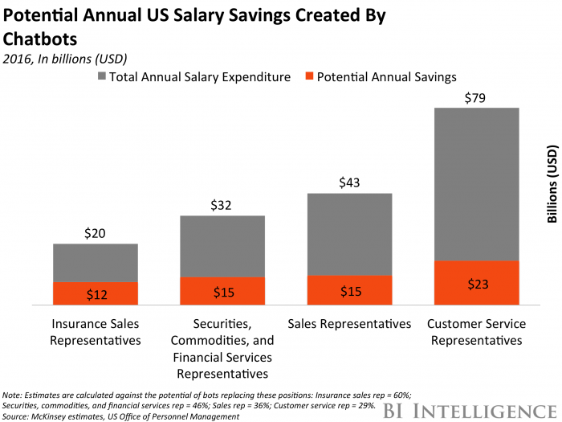
Opportunities
AUTOMATION SAVES MONEY
Simple/Tedious/Repetitive Tasks
Use for Internal Systems

Slide 27
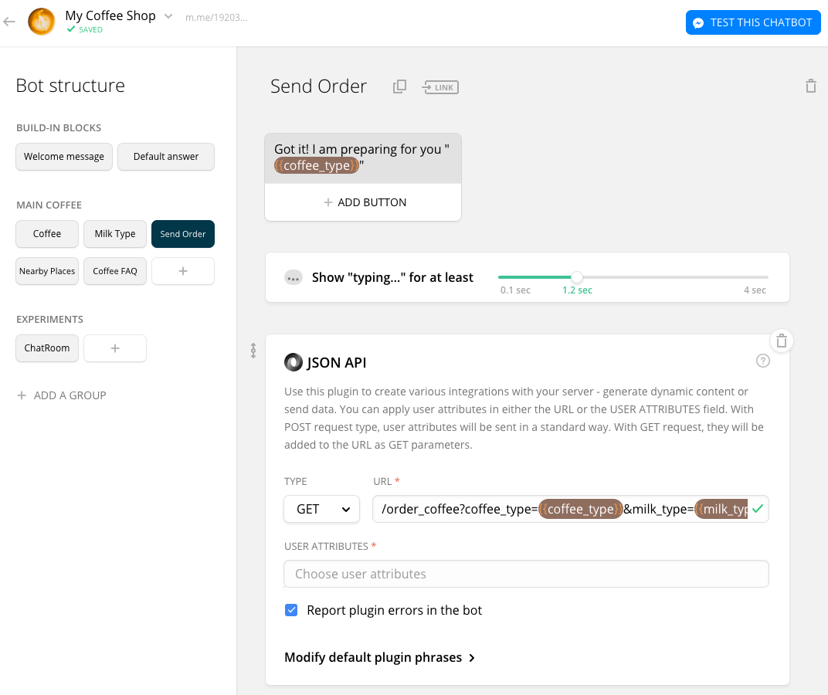
Opportunities
FAST TO DELIVER
SaaS providers can have bots online in minutes

Slide 28
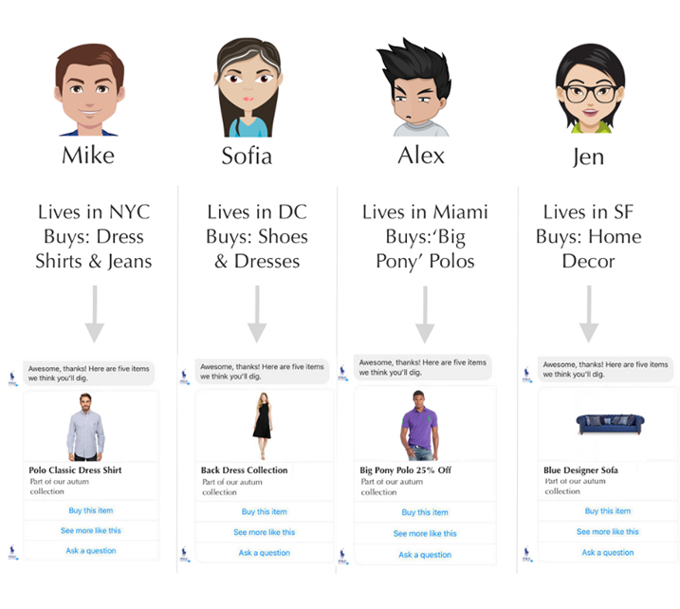
Opportunities
UBER-PERSONALISATION
Social Profile + CRM = targeted offering

Slide 29
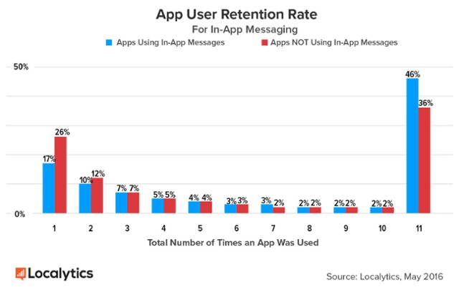
Opportunities
INCREASED RETENTION
10% Improvement in retention with messaging
26% Abandon after first use with no messaging

Slide 30
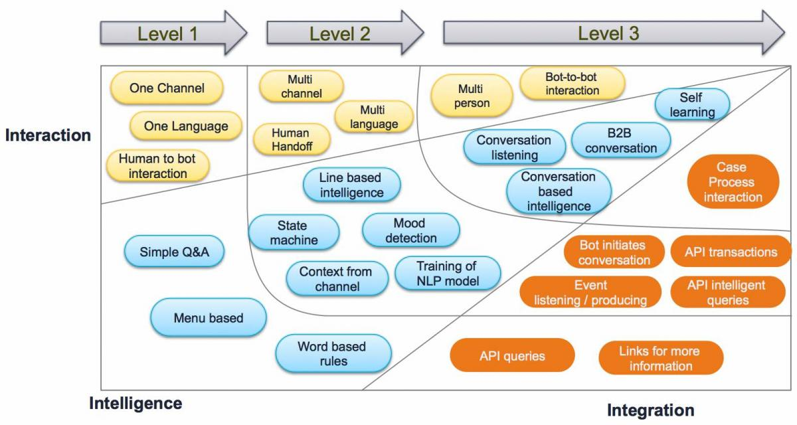
Opportunities
INTEGRATION
Notes:
Actually build once!!

Slide 31
LETS BUILD A BOT

Slide 32
TIPS & TRICKS

Slide 33
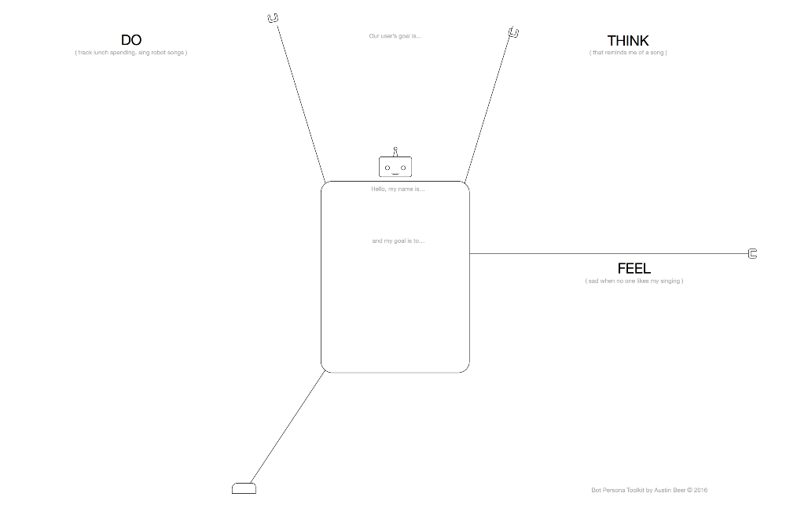
Notes:
Canvases are the consultants quadrants for startup people.

Slide 34
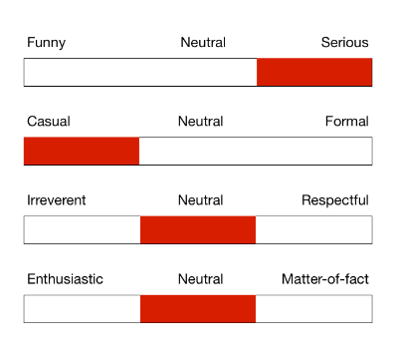
Tips and Tricks
PERSONALITY / VOICE
Use Personas
Have a Personality

Slide 35
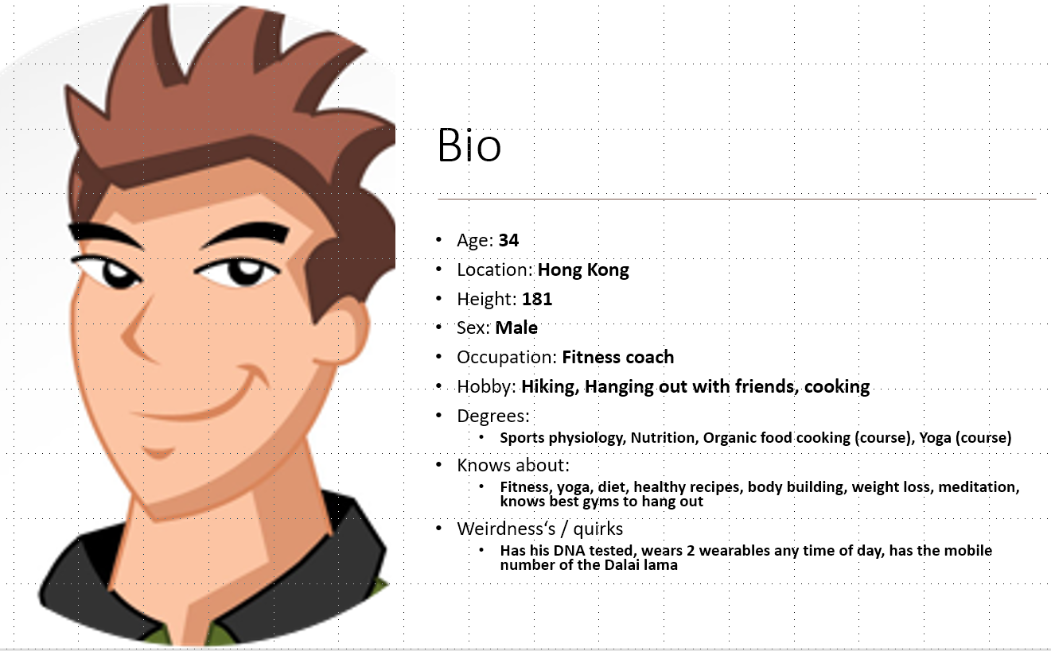
Tips and Tricks
BOUNDLSS’ BOT - ALEX
Casual & funny (but respectful)
Teasing & flirty
Understanding and confident
Fun to hang out with, takes too many selfies for Instagram

Slide 36
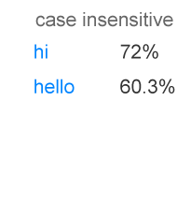
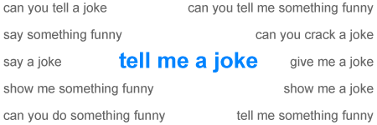
Tips and Tricks
DEAL WITH “SMALL TALK”
Most users start a conversation with ‘hi’ or ‘hello’
12% of users ask to be told a joke.
A lot of users also say rude things…

Slide 37
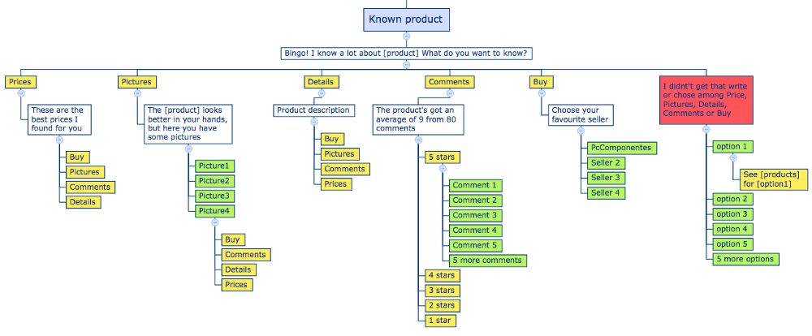
Tips and Tricks
PLAN CONVERSATIONS
NLP is a “nice to have” feature
Plan the User’s Journey
Notes:
NLP – 80% accuracy is still 20% wrong
“Rails” are pre-set conversation paths - Start with slash commands/rigid syntax
Follow the same user flow as you would if you were actually speaking to a person.
The bot shouldn’t sound too clever, using complicated grammar or language structures. Keep it simple and be concise.
Don’t use gender-specific pronouns, because you never know who’s on the other side of the conversation.
Add help messages and suggestions for when the user feels lost.
Write witty replies for unsupported topics, so that the bot doesn’t look dumb.

Slide 38
Tips and Tricks
GUILLERMO GETTE - /TODO SLACK APP
“I was putting so much effort on making it “conversational” and actually a few helps and hints was much easier and effective than spending hours on getting the models right.”
Notes:
NLP – 80% accuracy is still 20% wrong
“Rails” are preset conversation paths
NLP is syntactical analysis of free text input
Start with slash commands/rigid syntax,

Slide 39
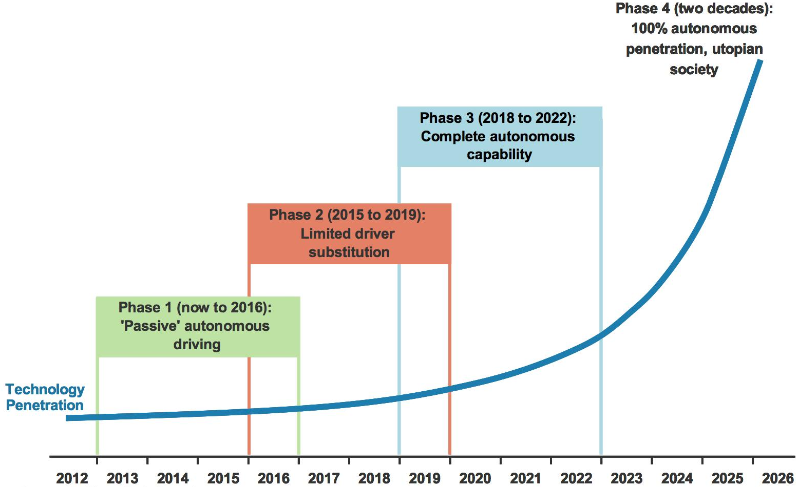
Autonomous Cars
FROM POWER STEERING TO DRIVERLESS CARS: MULTI STAGE STRATEGY
Level 1: single task e.g. assisted parking.
Level 2: multiple automated tasks, human monitoring.
Level 3: automation in structured environments e.g freeways.
Level 4: near full automation except in severe conditions.
Level 5: full automation, no human required.
39￼
39
Notes:
Deliver in phases as technology evolves

Slide 40
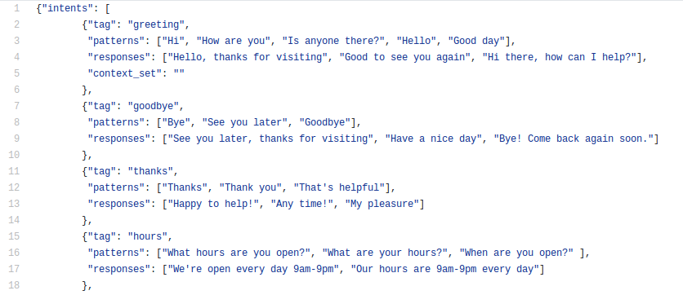
Tips and Tricks
PLAN CONVERSATIONS
Have variety in responses
Not everything has to be text!

Slide 41
Tips and Tricks
CHALLENGES
How do users find your bot?
High abandonment
Platforms are innovating quickly
Notes:
NLP – 80% accuracy is still 20% wrong
“Rails” are preset conversation paths
NLP is syntactical analysis of free text input
Start with slash commands/rigid syntax,

Slide 42
THANKYOU!
E: aidan.morgan@boundlss.com
T: @aidanjmorgan

